Slide 1
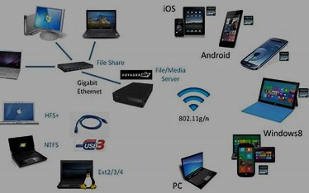

A STATISTICAL MODEL FOR WIRELESS SERVICE BUSINESS INDUSTRY
Tapan Barman
Department of statistics
b.Sc (sem-VI) Stat-17
Reg no: vb-3501 of 2020-21

Slide 2

Content
Introduction
Objectives
Data Description
Graphical Representation
Data Analysis
Interpretation
Conclusion
Reference

Slide 3
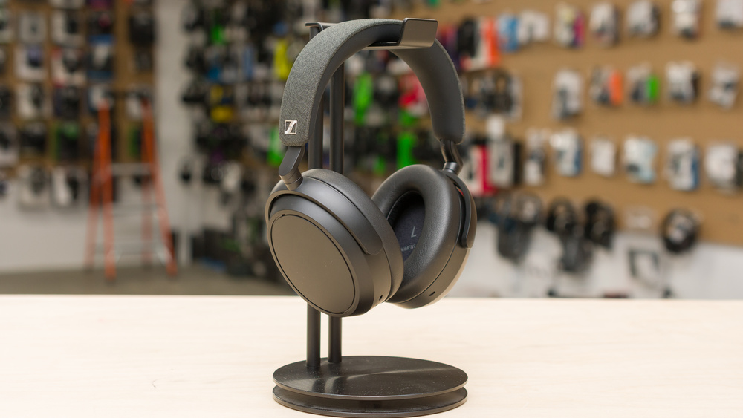
INTRODUCTION
Wireless service refers to any type of communication service that is delivered without the use of physical wires or cables. This type of service typically utilizes radio waves to transmit and receive data, voice, or video signals between devices.
Wireless services include various forms of wireless communication such as mobile phone services, wireless internet services, wireless home networking, and satellite communication. These services have become increasingly popular in recent years due to their convenience and accessibility. Mobile phone services, also known as cellular services, allow users to make calls, send text messages, and access the internet through a wireless network. Wireless internet services, also known as Wi-Fi, provide internet access to devices such as laptops, smartphones, and tablets without the need for physical cables.

Slide 4

OBJECTIVE
The main objective of this project are:
Finding most effectiveness between sales amount and manufacturing cost for more gross profit.
Demand analysis of wireless product.
Wireless product coverage.

Slide 5
DESCRIPTION OF THE DATA:
The data contains wireless service business information from various company. Name of the companies are Apple, Samsung, Incell, Castify, Tmobile, Sandisk, Huawei, H2O, Lycamobile, Xiaomi, Ultramobile, TCL, Temu etc. And the wireless items are earpod, type c cable, iwatch, mobilephone, cable, protective glass, phonecase, speaker, smartwatch etc. I was collect the data from a website which name is Kaggle.com . The data shows the above product’s manufacturing cost, sales amount, gross profit & commission cost.
DATA SOURCE: I have collect the data from
www.kaggle.com

Slide 6
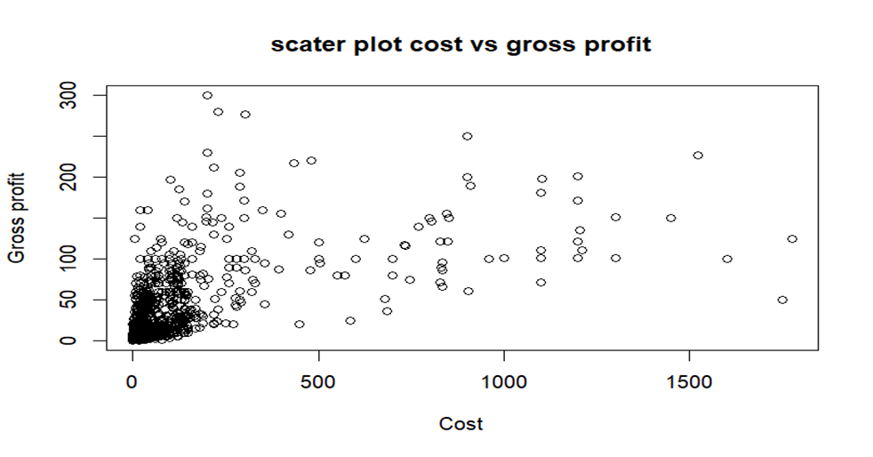
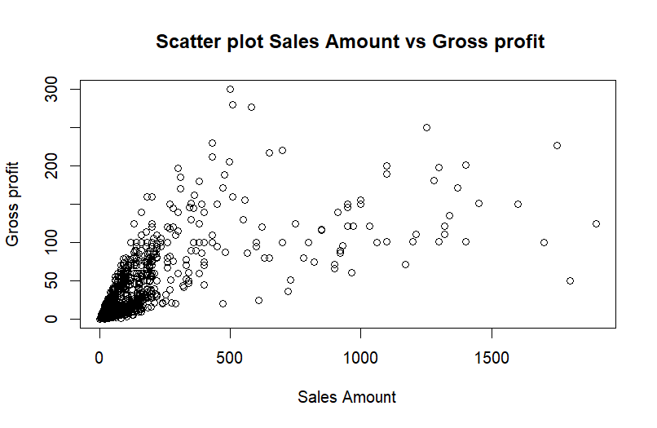
GRAPHICAL REPRESENTATION:
This are two scatter plot of sales amount vs gross profit and manufacturing cost vs gross profit.
FIG:01
FIG:02

Slide 7
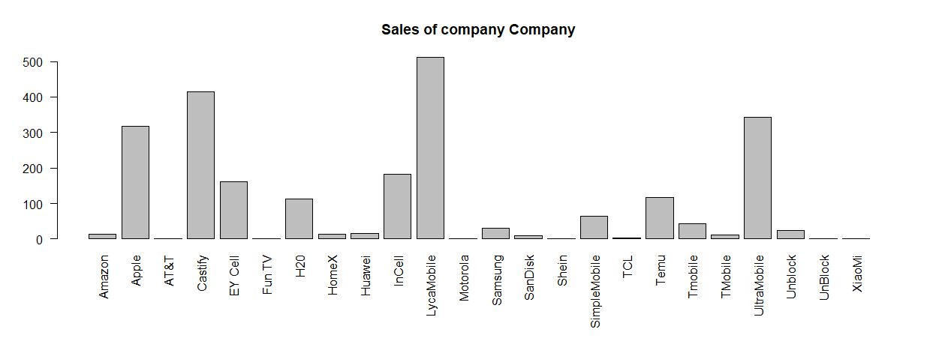
BAR PLOT: SALES OF DIFFERENT COMPANIES
Fig no:03

Slide 8
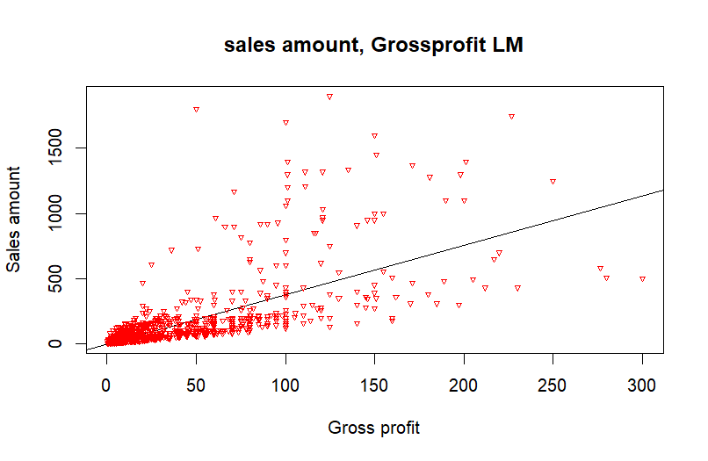
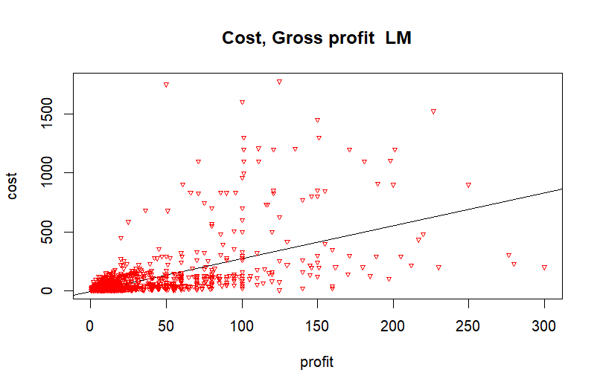
LINEAR MODELS: MANUFACTUTRING COST VS GROSS PROFIT AND SALES AMOUNT VS GROSS PROFIT
In figure no. 04 the linear models of manufacturing cost vs gross profit is shown.
FIG:05
In figure no 05 the linear models of sales amount and gross profit are shoen.
FIG:04

Slide 9
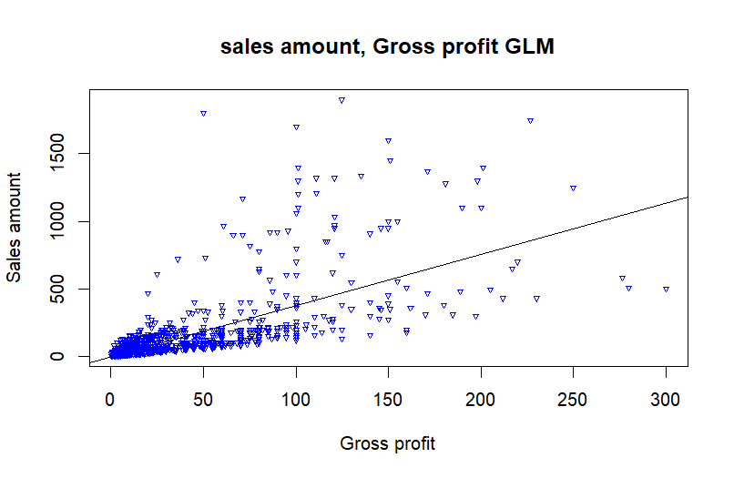
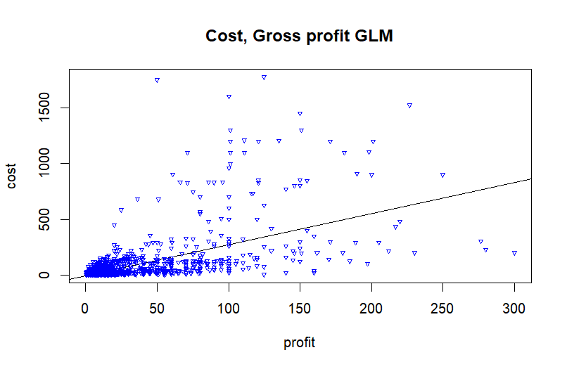
GENERALISED LINEAR MODEL: MANUFACTURING COST VS GROSS PROFIT AND SALES AMOUNT VS GROSS PROFIT
In figure no. 06 the generalised linear models of manufacturing cost vs gross profit is shown
FIG:07
In figure no. 07 the generalised linear models of sales amount vs gross profit is shown
FIG:06

Slide 10
DATA ANALYSIS
A preliminary impression from the graphical representation is that the data are not homoscedastic.
In statistics, a sequence of random variable is homoscedastic if all its random variables have the same finite variance; this is also known as homogeneity of variance. The complementary notion is called hetroscedasticity.
In statistics, heteroskedasticity (or heteroscedasticity) happens when the standard deviations of a predicted variable, monitored over different values of an independent variable or as related to prior time periods, are non-constant. With heteroskedasticity, the tell-tale sign upon visual inspection of the residual errors is that they will tend to fan out over time, as depicted in the image below.

Slide 11
HETEROSCEDASTICITY TEST: BP TEST
The Breusch-Pagan test is used to determine whether or not heteroscedasticity is present in a regression model.
The test uses the following null and alternative hypotheses:
Null Hypothesis (H₀): Homoscedasticity is present (the residuals are distributed with equal variance)
Alternative Hypothesis (H_{A}): Heteroscedasticity is present (the residuals are not distributed with equal variance)
If the p-value of the test is less than some significance level (i.e. α = .05) then we reject the null hypothesis and conclude that heteroscedasticity is present in the regression model.

Slide 12

RESULT AFTER BP TEST:
After doing the BP (Breusch-Pagan ) test we can see that the p-value is less than significance level(i.e. =0.05) So we reject the null hypothesis and conclude that heteroscedasticity is present in the regression model.
p-value<2.2e-16 (the residuals are not distributed with equal variance)

Slide 13
RESOLVING OF HETEROSKEDASTICITY:
The presence of heteroscedasticity can have several implications for statistical analysis:
Biased coefficient estimates
Inefficient standard errors
Incorrect hypothesis tests
So we need to reduce the heteroskedasticity before doing the Statistical work.To address heteroscedasticity, several techniques can be used:
Transforming the data (logarithmic, square root, or inverse transformations.)
Weighted least squares (WLS)
Robust standard errors

Slide 14
LOGARITHMIC TRANSFORMATION
The logarithmic transformation is a commonly used technique to reduce heteroscedasticity in data. It involves taking the logarithm of one or more variables, which can help stabilize the variance and make it more homogeneous. To apply the logarithmic transformation, I take the natural logarithm (base e). The choice of the base depends on the specific context and the properties of the data. The logarithmic transformation can be applied to the dependent variable, independent variables, or both, depending on the nature of the heteroscedasticity.
It's important to note that the logarithmic transformation may not always eliminate heteroscedasticity entirely, but it can often reduce its impact. Additionally, it's crucial to interpret the results of the transformed variables appropriately, as the coefficients and their interpretations may change after the transformation.

Slide 15
INTERPRETATION
While we are discussing two variables Sales Amount and Gross Profit:
The correlation coefficient between two variables, denoted as "cor(x, y1)," is 0.7559412(Where x is denoted Sales amount and y1 is denoted Gross Priofit). The correlation coefficient measures the strength and direction of the linear relationship between two variables. In this case, the correlation coefficient indicates a moderately strong positive correlation between variables x and y1. When the sales amount is increasing along with its gross profit, it generally indicates positive business performance and growth. Here are a few things we can understand from this scenario:
Increased Demand
Effective Pricing
Competitive Advantage

Slide 16
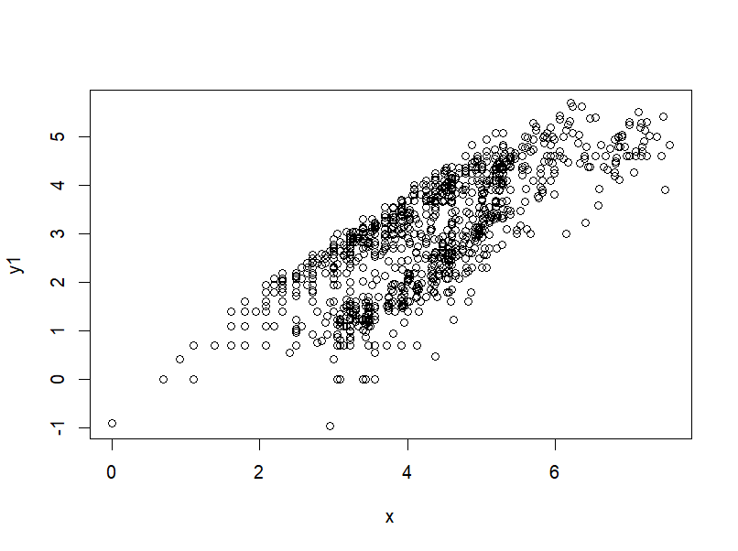
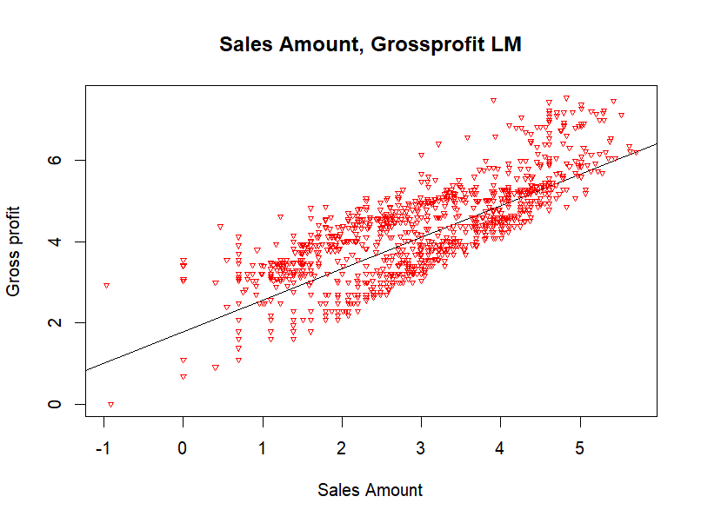
Linear Models of sales amount vs gross profit: after reducing the heteroscedasticity.

Slide 17
While we are disscussing two variables Manufacturing Cost & Gross Profit:
The correlation coefficient between variables x and y1, as calculated using the command "cor(x, y1)," is 0.5363185(Where x is denoted Manufacturing Cost and y1 is denoted Gross Priofit). This value indicates a moderate positive correlation between the two variables.When the cost is increasing along with its gross profit, it can indicate several things about the business's operations and financial health:
Cost Inflation
Production Expansion
Strategic Investments
Operational Inefficiencies

Slide 18
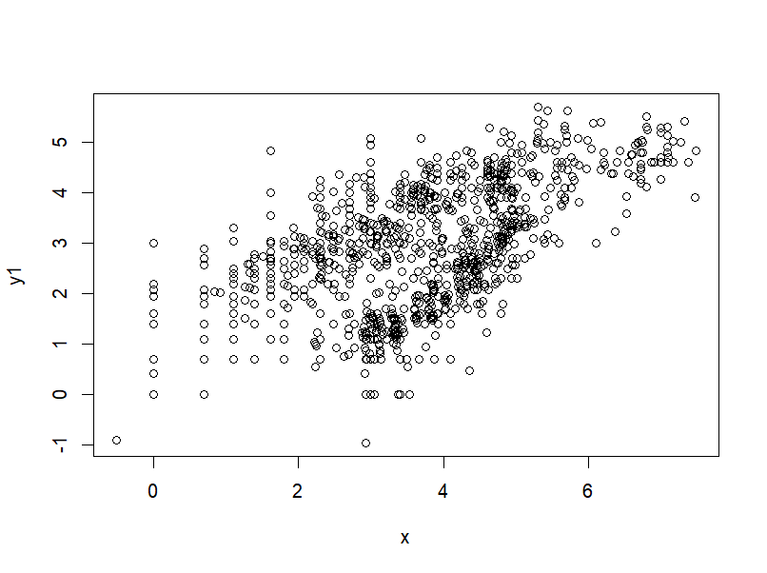
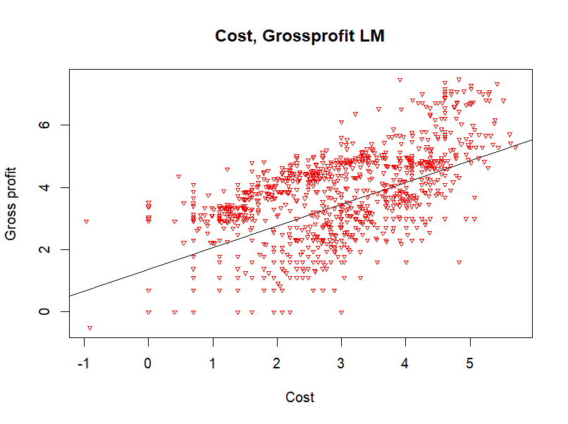
Linear Models of manufacturing cost vs gross profit:after reducing the heteroscedasticity.

Slide 19
CONCLUSION
The demand for wireless products indicates several things about consumer preferences and technological trends:The increasing demand for wireless products suggests that consumers value the convenience and mobility that wireless technology offers. Wireless products, such as wireless headphones, wireless speakers, or wireless charging devices, provide freedom from cables and enable users to easily connect and use devices without being physically tethered. This indicates that consumers appreciate the flexibility and portability that wireless technology provides.Wireless products often rely on wireless communication protocols such as Bluetooth, Wi-Fi, or NFC (Near Field Communication) to establish connections and interact with other devices. The growing demand for wireless products signifies the increasing desire for seamless connectivity and integration between various devices. Consumers want to connect their smartphones, tablets, smartwatches, and other devices effortlessly and enjoy a seamless experience across different platforms.

Slide 20
The increasing demand for wireless products may also suggest a decline in demand for traditional wired solutions. As wireless technology evolves and becomes more reliable, consumers are opting for wireless alternatives over traditional wired products. This shift in consumer preference is particularly evident in areas such as audio devices, where wireless headphones and speakers are becoming increasingly popular, gradually replacing wired counterparts.The demand for wireless products is closely linked to the growth of the Internet of Things (IoT) ecosystem. IoT refers to the interconnection of various devices and objects through the internet, enabling them to communicate and share data. Wireless connectivity is a key enabler for IoT devices, and the increasing demand for wireless products suggests a growing interest in smart home devices, wearable technology, and other IoT-enabled solutions.Overall, the demand for wireless products indicates a consumer preference for convenience, connectivity, and technological advancements. It reflects the evolving needs and expectations of consumers in a world where wireless technology is becoming increasingly prevalent and integral to our daily lives.

Slide 21
REFFERENCE
Fundamentals of Statistics (Vol 1) A. M. Gun, M. K. Gupta, B. Dasgupta
Fundamentals of Statistics (Vol-2) - A. M. Gun, M. K. Gupta, B. Dasgupta
An Outlines of Statistical Theory (Vol-2) - A. M. Gun, M. K. Gupta, B. Dasgupta
Fundamentals of Applied Statistics S. C. Gupta, V. K. Kapoor
Wikipedia
Google

Slide 22
ACKNOWLEDGEMENT
I would like to express my gratitude to several individuals who have supported me throughout the preparation of this project. Firstly, I am thankful to my supervisor, Dr. Debashis Chatterjee, for providing me with valuable guidance, feedback, and suggestions throughout the dissertation. I am also appreciative of the time and support he has given me. I would like to extend my special thanks to Dr. Sudhansu Sekhar Maiti, the Head of the Department of Statistics at Visva Bharati University, and several other faculty members including Dr. Arindam Chakraborty, Dr. Tirthankar Ghosh, Dr. Saran Ishika Maiti, Dr. Soumalaya Mukhopadhyay, and Dr. Sourav Rana for their unwavering support and encouragement during the challenging times. I could not have completed this project without their help. Finally, I would like to thank my friends who have been a constant source of support throughout these three years. They have stood by me in every situation and made this journey worthwhile. This project is not just a mere piece of work, but it represents the memories and mutual understanding that I have developed with the entire department. I have many emotions attached to this project, including respect and duty towards my teachers and educational attachment with my friends and college community.
Tapan Barman
B.SC. (HONS.) 3rd YEAR
Semester VI Department of Statistics
Institute of Science Visva-Bharati,
Santiniketan 731235

Slide 23

THANK YOU

